Slide 1

MINI PROJECT REVIEW Title: Comprehensive Malware Identification: Bridging Executables And Image Files
GUIDE
Mrs. Sandya Kanugu
TEAM MEMBERS
T. SAI KARTIK SHARMA(21891A66C5)
G. VIDYESH REDDY (21891A6677)
M. HEMANTH KUMAR (21891A6698)

Slide 2
Introduction
Malware (malicious software) refers to any software intentionally designed to cause damage to a computer, server, client, or computer network. Types of malware include viruses, worms, trojans, ransomware, spyware, adware, and rootkits.
PE files and images are a common file format for executables, DLLs, and other binaries in Windows operating systems. Due to their widespread use, PE files are a popular target for malware authors.
Malware Detection
Malware detection aims to identify and eliminate malicious software (malware) from computer systems. Malware can take various forms, including viruses, worms, trojans, spyware, and ransomware.
Traditional Methods
ML based Detection
Malware attacks worldwide (in billions)

Slide 3
Traditional Methods
Signature-Based Detection
Relies on known patterns of malware (signatures) to identify threats.
Pros: High accuracy for known malware, low false positives.
Cons: Ineffective against new, unknown malware (zero-day threats), requires frequent updates.
Behavior-Based Detection
Monitors the behavior of programs at runtime to identify malicious activities.
Pros: Effective against unknown and polymorphic malware, dynamic analysis.
Cons: Resource-intensive, may not detect malware until after execution.

Slide 4
Machine Learning approach
Machine learning has revolutionized malware detection by providing adaptive and predictive capabilities.
ML algorithms can learn from vast amounts of data to identify patterns and anomalies associated with malware.
Techniques such as supervised learning, unsupervised learning, and deep learning have been applied to enhance detection accuracy.
ML models can handle large datasets, and helps in predicting the malware efficiently.

Slide 5
LITERATURE SURVEY
S.No | Year | Author(s) | Title | Methodology | Merits | Demerits
1 | 2020 | Garminla Sampath Kumar, Pooja Bagan | Detection Of Malware Using Deep Learning Techniques | ML, DL models are used in detection of Malware by converting them into images. | The Model primarily focuses of representing the MALWARE in files. | The detection primarily focuses on static analysis of MALWARE file structures. It may miss malware hidden using dynamic techniques
S.No | Year | Author(s) | Title | Methodology | Merits | Demerits
2 | 2020 | AVIAD COHEN, NIR NISSIM, AND YUVAL ELOVICI | MalJPEG: Machine Learning Based Solution for the Detection of Malicious JPEG Images | ML model is trained on the datasets only and only works with JPEG format | Works with high accuracy for MALWARE JPEG files. | The system is designed specifically for JPEG files, meaning it cannot detect malware in other image formats like PNG, BMP, or GIF, which are also common attack vectors

Slide 6
LITERATURE SURVEY
S.No | Year | Author(s) | Title | Methodology | Merits | Demerits
3 | 2020 | AKRAM M. RADWAN | Machine Learning Techniques to Detect Maliciousness of Portable Executable Files | ML model is trained on the datasets only and only works with Portable Executables (.exe) | Works with high accuracy for known .exe files. | The system is limited to Portable Executable files and does not support other file formats (e.g., PDF, DOCX, or ZIP files etc. ), which limits the system's applicability to other types of malware that exploit different file types.

Slide 7
PROBLEMS IN EXISTING SYSTEM
File Format Limitation (Only JPEG)
Issue: The system is designed specifically for JPEG files, meaning it cannot detect malware in other image formats like PNG, BMP, or GIF, which are also common attack vectors.
Generalization to Future Malware:
Issue: The system might struggle with detecting novel malware that uses advanced techniques or other image formats to evade detection.
Focus on Static Analysis (JPEG Structure):
Issue: The detection primarily focuses on static analysis of JPEG file structures. It may miss malware hidden using dynamic techniques (e.g., payloads activated upon execution).
No Handling of Other Non-Executable Files:
Issue: The model currently handles .exe, .msi files only. Other non-executable files like PDFs, DOCX, and ZIPs are not analyzed, limiting the scope of detection to just images.

Slide 8
PROPOSED SOLUTION
Our proposed methodology leverages machine learning to detect malware in Portable Executable (PE) files and also images.
The process involves collecting a dataset of PE files and image files, extracting relevant features, training machine learning models, and evaluating their performance to identify malicious files with high accuracy.
Develop a comprehensive framework that supports various image formats (e.g., PNG, BMP) by adapting the feature extraction methods used for JPEG to accommodate the structures of these other formats.

Slide 9
SOFTWARE REQUIREMENTS
Python Version Python 3.7 or higher: Recommended for compatibility with the latest libraries and frameworks.
Libraries or Frameworks Machine Learning: TensorFlow or PyTorch
Data Manipulation: Pandas, NumPy
Image Processing: Pillow
PE File Analysis: Pefile
Steganography Detection: Libraries such as Stegano
9

Slide 10
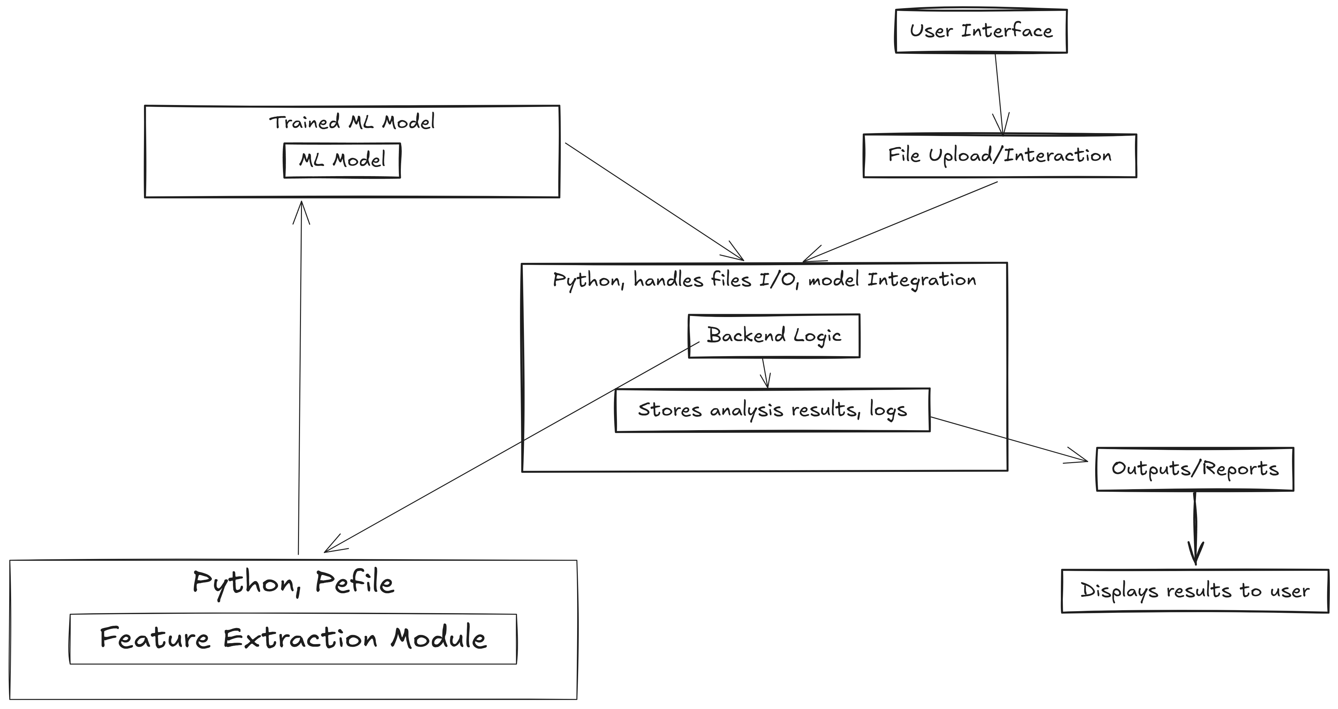
Architecture and Components

Slide 11
references
MalJPEG: Machine Learning Based Solution for the Detection of Malicious JPEG Images | IEEE Journals & Magazine | IEEE Xplore
Detection of Malware Using Deep Learning | IEEE Conference Publication | IEEE Xplore
Feature Extraction and Analysis of Portable Executable Malicious File | IEEE Conference Publication | IEEE Xplore

Slide 12
THANK YOU
TEAM MEMBERS
T. SAI KARTIK SHARMA(21891A66C5)
G. VIDYESH REDDY (21891A6677)
M. HEMANTH KUMAR (21891A6698)

